Slide 1
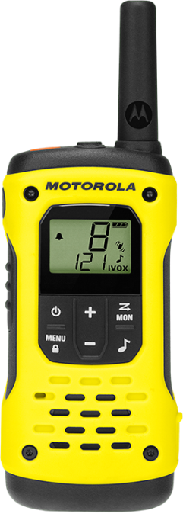

Slide 2
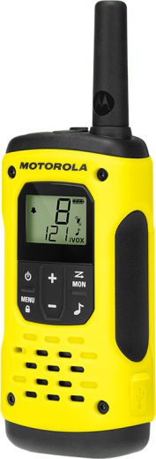
INTRODUCTION
TALKABOUT T92 H₂0 is back, packed with the same premium features and floating waterproof design, plus an updated look with superior water drainage and additional charging options to keep you connected anywhere you go with family and friends.
Waterproof IP67¹
PMR446 Radios -
License Free
Water-activated Torch
Dual Power &
USB Charging
Floats face up
16 Channels⁴
Plus 121 Privacy Codes

Slide 3
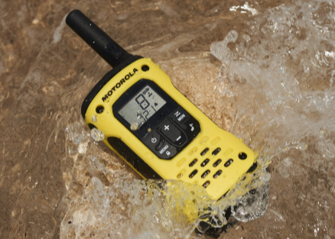
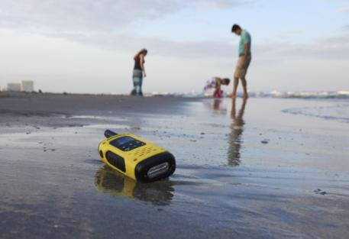
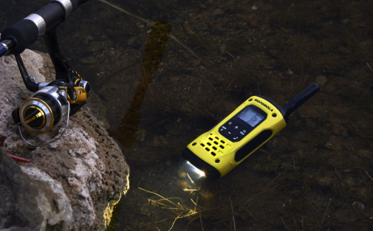
IP67 WATERPROOF
WHILE SPLASH-PROOF MAY BE THE STANDARD FOR OTHER CONSUMER RADIO MANUFACTURERS, IT IS JUST THE STARTING POINT FOR THE TALKABOUT T92 H₂0
These radios are IP67 waterproof¹. That means they can withstand submersion in water in depths up to 1 metre for 30 minutes. The T92 H₂0 will also float to the surface - face upwards - for easy retrieval when dropped in water.
Waterproof IP67
Floats face up

Slide 4
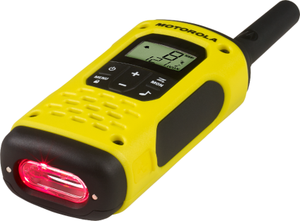
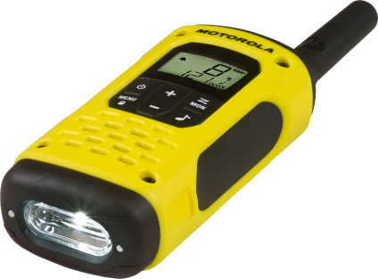
TORCH
THE TALKABOUT T92 H₂0 INTEGRATED TORCH MEANS THAT YOU NEVER NEED TO GET CAUGHT IN THE DARK.
Press once to activate the red LED that preserves night vision but lets you find your way to the campsite, or follow the trail without disturbing the wilderness around you! Press again to activate the white LED for bright clear torch light.
In addition, the torch has water sensors – so when dropped in water the white LED will automatically switch on, making your T92 H₂0 easy to spot and retrieve!
Water-Activated Torch
Automatically turns on
on contact with water

Slide 5
FREQUENCIES
ALL TALKABOUT RADIOS UTILISE PMR446 UNLICENSED FREQUENCIES FOR EASY, COST EFFECTIVE OPERATIONS.
No subscription or call charges and 16 channels⁴ with 121 user selectable privacy codes per channel help ensure a clear signal, with a range of up to 10km.
TALKABOUT T92 H₂0 radios are also compatible with all other TALKABOUT PMR446 radios and any other radio operating on the same PMR446 frequencies.
PMR446 Unlicensed Frequencies

Slide 6
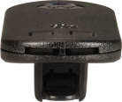
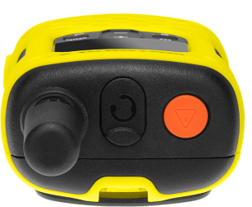
EMERGENCY FEATURES
WE NOT ONLY WANT TO KEEP YOU CONNECTED ON YOUR WILDEST ADVENTURES, WE WANT TO KEEP YOU SAFE! WE DESIGNED THE TALKABOUT T92 H₂0 WITH ADDED EMERGENCY FEATURES FOR ADDED SAFETY AND PEACE OF MIND.
The TALKABOUT T92 H₂0 belt clip doubles up as a whistle – if you need to draw attention to yourself simply disconnect from the radio and blow!
There is also an orange emergency button³ on the top of the T92 H₂0. Press and hold for 3 seconds and a loud alarm will sound, and also activate the hands free (iVOX) feature for you to transmit your call to your group requesting help.
Whistle Belt Clips

Slide 7
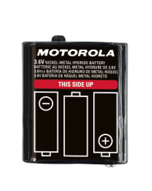
BATTERY LIFE
UP TO 17 HOURS⁵BATTERY LIFE ON A SINGLE CHARGE, THE TALKABOUT T92 H₂0 ENSURES YOU CAN STAY IN TOUCH ON EVEN THE LONGEST DAY OF ADVENTURES.
The TALKABOUT T92 H₂0 is supplied as standard with an 800mAh NiMH rechargeable battery pack to give up to 17 hours operation.
Need longer runtime? No problem! You can also use standard AA batteries or the optional high capacity 1300mAh battery pack.
Note that these options could reduce the radio’s capacity to float when dropped in water.
Dual Power
Use rechargeable NiMH
batteries included, or
3 AA batteries

Slide 8
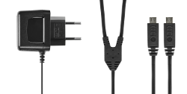
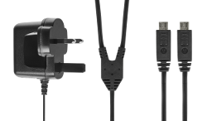
CHARGING
CHARGE TWO TALKABOUT T92 H₂0 WALKIE-TALKIES AT ONCE USING THE SUPPLIED MICRO USB CHARGER SO YOUR T92 H₂0 IS READY WHEN YOU HEAD OUT ON YOUR NEXT ADVENTURE.
TALKABOUT T92 H₂0 is supplied with both a 2-pin EURO and 3-pin UK plug charger with Y-cable, so you can charger two walkie-talkies at the same time.
USB CHARGING
2 wall chargers included in every box

Slide 9
FEATURES
HIGHLIGHTS:
PMR446 license free
16 channels⁴ + 121 codes per channel
Up to 10km range²
IP67 waterproof¹ – submersible up to 1 metre for 30 minutes
Floats face up when dropped in water¹
LED torch with bright white and red modes plus water-contact activation
Micro-USB port for charging
2.5mm headset jack
LCD display with backlight
Emergency alert button³
Belt clips with built in whistle
20 call tones
Vibrate alert
Priority Scan
Channel Monitor
Hands-free VOX
Talk confirmation tone/Roger beep
Rechargeable NiMH batteries included
IP67 Waterproof¹
Submersible in water for up to 1m for
30 minutes
Water-Activated Torch
Torch automatically lights on contact
with water
Easy-to-
Retrieve
Floats face up and features water activated torch light
Whistle Belt Clips
Help to attract
attention from others when blown
Dual
Power
Rechargeable NiMH batteries included, or
3 AA batteries
Micro USB Charging
Use mains charger included or any standard USB charger
PMR446 Compatible
Receives calls from
all PMR446
two-way radios
iVOX
/VOX
Hands free operation with or without accessories

Slide 10
NOTES
¹ This radio meets IP67 standards. It will withstand submersion of up to 1 metre for 30 minutes. Radio floats with included NiMH battery. It may not float with some AA batteries. Use of headset should be in dry environments only.
² The communication range quoted is calculated based on an unobstructed line of sight test under optimum conditions. Actual range will vary depending on terrain and conditions, and is often less than the maximum possible. Your actual range will be limited by several factors including, but not limited to terrain, weather conditions, electromagnetic interference and obstructions.
³ The Emergency Alert feature should only be used in the event of an actual emergency. Motorola Solutions is not responsible if there is no response to the emergency alert from the receiving group.
⁴ Restricted to 8 channels in Russia by law. Please refer to user guide.
⁵ Battery time quoted is based on standard usage of 5/5/90 cycle.

Slide 11
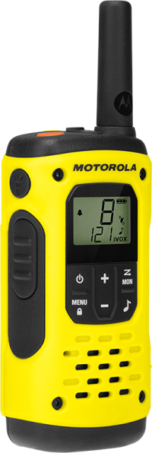
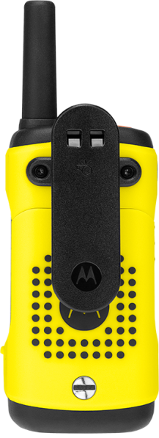
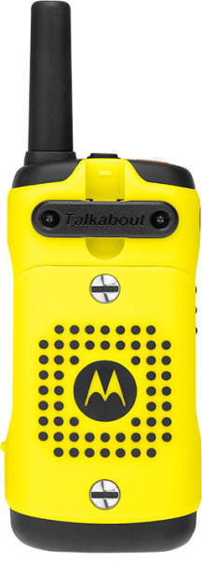
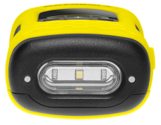
DESIGN

Slide 12
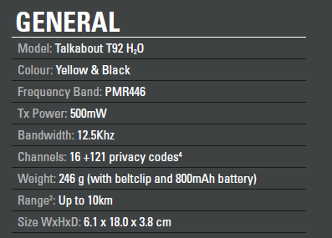
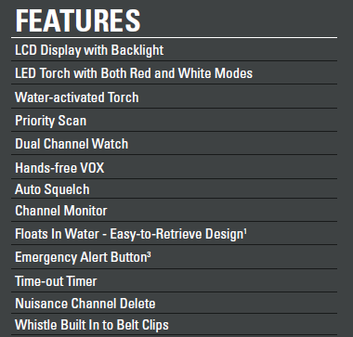
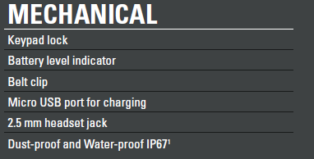
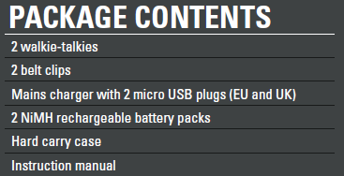
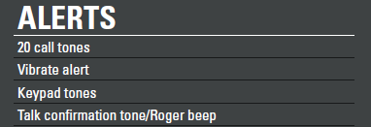
SPECIFICATIONS

Slide 13
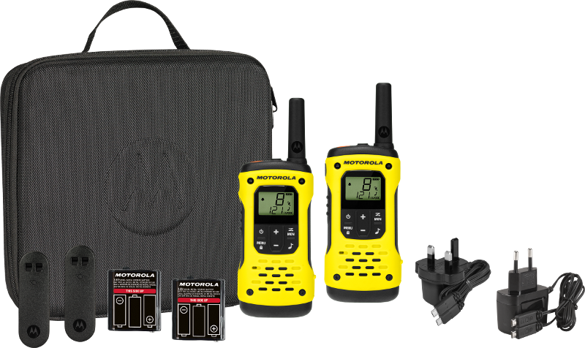
PACK CONTENTS
2x T92 H₂0 walkie-talkies
1x Carry Case
2x Whistle Belt Clips
2x NiMH Battery Packs
1x UK Mains Charger
1x EURO Mains Charger
User Documentation

Slide 14
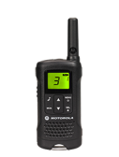
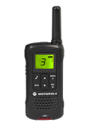
POSITIONING
VERTICAL
TLKR
T81 HUNTER (SINGLE)
TALKABOUT T92 H₂0
HIGH
TALKABOUT
T82
TALKABOUT
T82 EXTREME
MID
TLKR
T50
TLKR
T60/T61
TALKABOUT T62
ENTRY
TLKR
T40/41
TALKABOUT T42

Slide 15
DIMENSIONS
Handset W x H x D | Handset Weight (with included battery and belt clip) | Battery Type (Included) | Battery Weight | Giftbox W x H x D | Giftbox Weight (Empty) | Giftbox Weight (Full) | Shipper Box Qty | Shipper Box W x H x D
61 x 180 x 38 mm | 246g | NiMH | 59g | 235 x 234 x 70 mm | 0.32kg | 1.126kg | 6PCS/CTN | 470 x 270 x 260 mm
Shipper Box Weight (Full) | Shipper Box Per Pallet | Giftbox Box Per Pallet | Full Pallet W x H x D | Full Pallet Weight | Giftbox Qty 20ft Container | Giftbox Qty 40ft Container | Giftbox Qty 45ft Container
7.22kg | 18 | 108 | 80 x 120 x 96 cm | 155.96kg | 3024 | 6048 | 6912

Slide 16
www.motorolasolutions.com/walkie-talkie
Availability is subject to individual country law and regulations. All specifications shown are typical unless otherwise stated and are subject to change without notice.
MOTOROLA, MOTO, MOTOROLA SOLUTIONS and the Stylized M Logo are trademarks or registered trademarks of Motorola Trademark Holdings, LLC and are used under license.
All other trademarks are the property of their respective owners. © 2018 Motorola Solutions, Inc. All rights reserved.

